Slide 1

Introduction to Project Management

Slide 2
Learning Objectives
Understand the growing need for better project management, especially for information technology projects
Explain what a project is, provide examples of information technology projects, list various attributes of projects, and describe the triple constraint of projects
Describe project management and discuss key elements of the project management framework, including project stakeholders, the project management knowledge areas, common tools and techniques, and project success

Slide 3
Learning Objectives (continued)
Discuss the relationship between project, program, and portfolio management and the contributions they each make to enterprise success
Understand the role of the project manager by describing what project managers do, what skills they need, and what the career field is like for information technology project managers
Describe the project management profession, including its history, the role of professional organizations like the Project Management Institute, the importance of certification and ethics, and the advancement of project management software

Slide 4
Advantages of Using Formal Project Management
Better control of financial, physical, and human resources
Improved customer relations
Shorter development times
Lower costs and improved productivity
Higher quality and increased reliability
Higher profit margins
Improved productivity
Better internal coordination
Positive impact on meeting strategic goals.
Higher worker morale (less stress)

Slide 5
What Is a Project?
A project is “a temporary endeavor undertaken to create a unique product, service, or result”
Operations is work done to sustain the business
Projects end when their objectives have been reached or the project has been terminated
Projects can be large or small and take a short or long time to complete

Slide 6
Examples of IT Projects
A help desk or technical worker replaces ten laptops for a small department
A small software development team adds a new feature to an internal software application for the finance department
A college campus upgrades its technology infrastructure to provide wireless Internet access across the whole campus

Slide 7
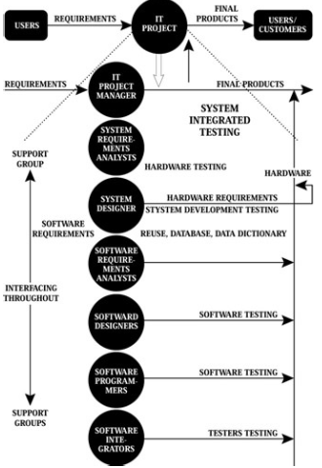
Various phase of the IT Project

Slide 8
Project Attributes
A project:
Has a unique purpose
Is temporary
Is developed using progressive elaboration
Requires resources, often from various areas
Should have a primary customer or sponsor
The project sponsor usually provides the direction and funding for the project
Involves uncertainty

Slide 9
Project Constraints
Scope
What work will be done as part of the project?
What unique product,service, or result does the customer or sponsor expect from the project?
How will the scope be verified?
Time
How long should it take to complete the project?
What is the project’s schedule?
How will the team track actual schedule performance? Who can approve changes to the schedule?
Cost
What should it cost to complete the project? What is the project’s budget?
How will costs be tracked? Who can authorize changes to the budget?

Slide 10
Project and Program Managers
Project managers work with project sponsors, a project team, and other people involved in a project to meet project goals
Program: group of related projects managed in a coordinated way to obtain benefits and control not available from managing them individually
Program managers oversee programs and often act as bosses for project managers

Slide 11
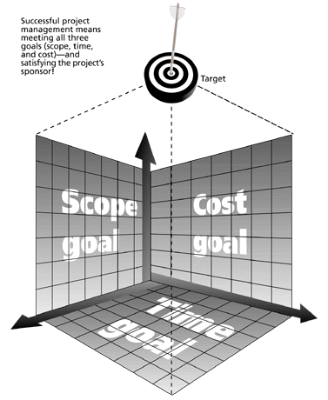
The Triple Constraint of Project Management
Successful project management means meeting all three goals (scope, time, and cost) – and satisfying the project’s sponsor!

Slide 12
What is Project Management?
Project management is “the application of knowledge, skills, tools and techniques to project activities to meet project requirements”
Project managers strive to meet the triple constraint by balancing project scope, time, and cost goals

Slide 13
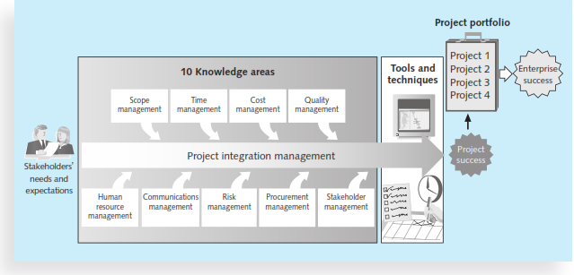
Project Management Framework

Slide 14
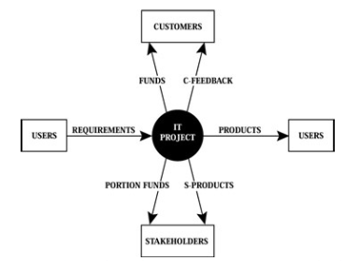
Relationship among user, stakeholders and customers

Slide 15
Project Stakeholders
Stakeholders are the people involved in or affected by project activities
Stakeholders include:
The project sponsor
The project manager
The project team
Support staff
Customers
Users
Suppliers
Opponents to the project

Slide 16
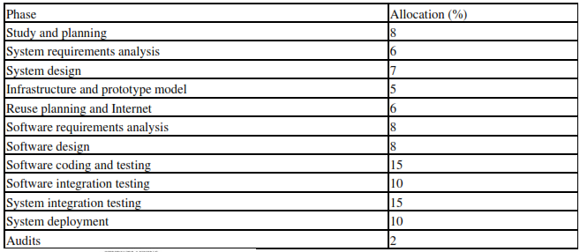
Allocation of IT project Resources

Slide 17
Project Management Knowledge Areas
Project scope management involves defining and managing all the work required to complete the project successfully.
Project time management includes estimating how long it will take to complete the work, developing an acceptable project schedule, and ensuring timely completion of the project.
Project cost management consists of preparing and managing the budget for the project.
Project quality management ensures that the project will satisfy the stated or implied needs for which it was undertaken.

Slide 18
Project Management Knowledge Areas
Project human resource management is concerned with making effective use of the people involved with the project.
Project communications management involves generating, collecting, disseminating, and storing project information.
Project risk management includes identifying, analyzing, and responding to risks related to the project.
Project procurement management involves acquiring or procuring goods and services for a project from outside the performing organization.

Slide 19
Project Management Knowledge Areas
Project stakeholder management includes identifying and analyzing stakeholder needs while managing and controlling their engagement throughout the life of the project.
Project integration management is an overarching function that affects and is affected by all of the other knowledge areas.

Slide 20
Project Management Tools and Techniques
Project management tools and techniques assist project managers and their teams in various aspects of project management
Some specific ones include:
Project charter, scope statement, and WBS (scope)
Gantt charts, network diagrams, critical path analysis, and critical chain scheduling (time)
Cost estimates and earned value management (cost)

Slide 21
Super Tools
“Super tools” are those tools that have high use and high potential for improving project success, such as:
Software for task scheduling (such as project management software)
Scope statements
Requirements analyses
Lessons-learned reports
Tools already extensively used that have been found to improve project importance include:
Progress reports
Kick-off meetings
Gantt charts
Change requests

Slide 22
Project Success
There are several ways to define project success
The project met scope, time, and cost goals
The project satisfied the customer/sponsor
The results of the project met its main objective, such as making or saving a certain amount of money, providing a good return on investment, or simply making the sponsors happy

Slide 23
What Helps Projects Succeed?*
1. Executive support
2. User involvement
3. Experienced project manager
4. Clear business objectives
5. Minimized scope
6. Standard software infrastructure
7. Firm basic requirements
8. Formal methodology
9. Reliable estimates
10. Other criteria, such as small milestones, proper planning, competent staff, and ownership
*The Standish Group, “Extreme CHAOS,” (2001).

Slide 24
Suggested Skills for Project Managers
Project managers need a wide variety of skills
They should:
Be comfortable with change
Understand the organizations they work in and with
Be able to lead teams to accomplish project goals

Slide 25
The Role of the Project Manager
Job descriptions vary, but most include responsibilities like planning, scheduling, coordinating, and working with people to achieve project goals
Remember that 97% of successful projects were led by experienced project managers, who can often help influence success factors

Slide 26
Suggested Skills for Project Managers
The Project Management Body of Knowledge
Application area knowledge, standards, and regulations
Project environment knowledge
General management knowledge and skills
Soft skills or human relations skills

Slide 27
Ten Most Important Skills and Competencies for Project Managers
1. People skills
2. Leadership
3. Listening
4. Integrity, ethical behavior, consistent
5. Strong at building trust
6. Verbal communication
7. Strong at building teams
8. Conflict resolution, conflict management
9. Critical thinking, problem solving
10. Understands, balances priorities

Slide 28
Project-Related Characteristics
Achieves the objectives and goals of the project within the established schedule, budget, and procedures
Develops IT projects on budget and on time to the complete satisfaction of the users
Has experience in related or similar projects
Can control project outcomes by measuring and evaluating performance against established objectives and standards
Develops and executes contingency plans to meet unforeseen circumstances and problem

Slide 29
Team-Related Characteristics
Has good communication and managerial skills
Is able to plan, organize, lead, motivate, and delegate proper responsibilities to team members
Respects team members and has their confidence and respect•
Shares success with the team members•
Selects the right person for the right job•
Shows appreciation to good workers•
Gets others in the organization to accept his or her ideas and carry out his or her plans

Slide 30
Team-Related Characteristics
Delegates duties and maintains control
Believes in professionally training people for their delegated jobs
Considers himself or herself as a part of the team
Creates structured discipline
Recognizes individual differences and takes advantage of individual strengths
Provides work that stimulates a feeling of personal respect and professional growth
Allows sufficient time for ideas to develop and mature

Slide 31
Team-Related Characteristics
Allows free time and encourages openness
Understands the team members and creates effective communication
Monitors his or her team members on a regular basis for the following types of people and takes necessary actions:
People who waste their time and that of others
Opportunists who steal others' ideas
Critical people who find only mistakes in others' work
Idle people who are unproductive
Egotistic people who brag about themselves
Gossips who spread rumors

Slide 32
Project-Related Characteristics
Develops and implements decisions relating to planning
Is willing to redefine goals, responsibilities, and schedules as necessary to get the project back on track in case the schedule slips or the project is over budget
Establishes and meets real priorities and deadlines
Believes in good planning to reduce pressure and stress and increase productivity
Establishes long-term and short-term planning

Slide 33
Different Skills Needed in Different Situations
Large projects: leadership, relevant prior experience, planning, people skills, verbal communication, and team-building skills are most important
High uncertainty projects: risk management, expectation management, leadership, people skills, and planning skills are most important
Very novel projects: leadership, people skills, having vision and goals, self-confidence, expectations management, and listening skills are most important

Slide 34
Importance of Leadership Skills
Effective project managers provide leadership by example
A leader focuses on long-term goals and big-picture objectives while inspiring people to reach those goals
A manager deals with the day-to-day details of meeting specific goals
Project managers often take on the role of both leader and manager

Slide 35
Careers for IT Project Managers
Computerworld’s annual forecast survey supports this career projection.
IT executives listed the “nine hottest skills” they planned to hire for in 2012.
Programming and application development took over first place from project management, mainly due to the increased need for programmers of mobile devices.
Managers also noted that they were looking for “working” project managers and business analysts who could get projects done.

Slide 36
The Project Management Profession
The profession of project management is growing at a very rapid pace
It is helpful to understand the history of the field, the role of professional societies like the Project Management Institute, and the growth in project management software

Slide 37
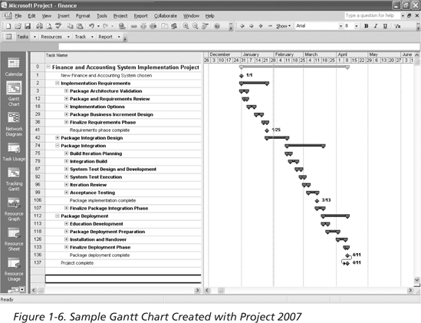
Figure 1-6: Sample Gantt Chart Created with Project 2007

Slide 38
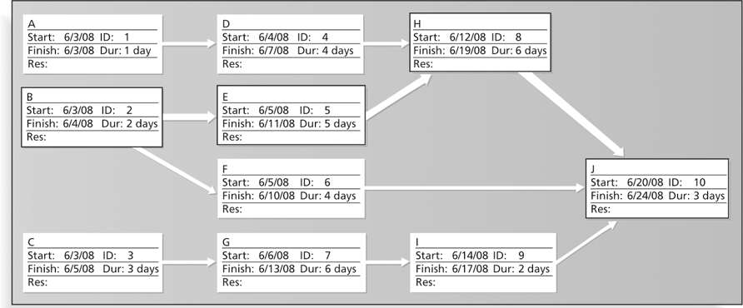
Figure 1-7: Sample Network Diagram in Microsoft Project

Slide 39
Ethics in Project Management
Ethics, loosely defined, is a set of principles that guide our decision making based on personal values of what is “right” and “wrong”
Project managers often face ethical dilemmas
In order to earn PMP certification, applicants must agree to PMI’s Code of Ethics and Professional Conduct
Several questions on the PMP exam are related to professional responsibility, including ethics

Slide 40
Project Management Software
There are hundreds of different products to assist in performing project management
Three main categories of tools
Low-end tools: handle single or smaller projects well, cost under $200 per user
Midrange tools: handle multiple projects and users, cost $200-600 per user, Project 2007 most popular
High-end tools: also called enterprise project management software, often licensed on a per-user basis, like VPMi Enterprise Online (www.vcsonline.com); see front cover for trial version information
See the Project Management Center Web site or Top Ten Reviews for links to many companies that provide project management software

Slide 41
Chapter Summary
A project is a temporary endeavor undertaken to create a unique product, service, or result
Project management is the application of knowledge, skills, tools, and techniques to project activities to meet project requirements
A program is a group of related projects managed in a coordinated way; project portfolio management involves organizing and managing projects and programs as a portfolio of investments
Project managers play a key role in helping projects and organizations succeed
The project management profession continues to grow and mature

